Slide 1
Beyond What “Is” and What “Is-Not”
Thomas G. Szabo, PhD, BCBA
Florida Institute of Technology
Well, Florida yes… in California, that is!

Slide 2
I am holding a #2 lead pencil in my hand. I’m rolling the pencil in my fingers and wiggling it between my index and middle fingers. What is it this thing in my fingers? A pencil, right? Say it out loud. Pencil.
Notes:
I am holding a #2 lead pencil in my hand at this moment, and authoring the paper you are reading by use of Dragon software. I’m rolling the pencil in my fingers and wiggling it between my index and middle fingers. What is it this thing in my fingers? A pencil, right? Say it out loud. Pencil. That’s what it is. To you… but not to my dog. To my dog, this is a plaything, a toy to wrest from my hand, run with, and invite me into a chase game. This thing is the thing I experience it to be, but others might experience it and characterize it differently. However, it is the relation that others have with this thing that gives it its identifiability, not any innate thingness within it.

Slide 3
That’s what it is. To you…
Notes:
To you… given your history of interaction with things such as this. Given your history of action with respect to things such as this, it’s stimulus functions occur in a particular way to you.

Slide 4
But not to my dog. To my dog, this is a plaything. It’s a toy to wrest from my hand, to run with, and to invite me to chase with him.

Slide 5
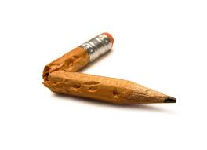
Just try and convince him otherwise, without offering him an alternative.
Good luck with that.

Slide 6
This thing functions for me as a pencil in a particular context, thus I characterize it that way based on my use of it. At the same time, others might experience it and characterize it differently. Thus, it is the relation that we have with a thing in context that gives it its identifiability, not any innate thingness within it.
PENCIL
PLAYTOY
Notes:
I am holding a #2 lead pencil in my hand at this moment, and authoring the paper you are reading by use of Dragon software. I’m rolling the pencil in my fingers and wiggling it between my index and middle fingers. What is it this thing in my fingers? A pencil, right? Say it out loud. Pencil. That’s what it is. To you… but not to my dog. To my dog, this is a plaything, a toy to wrest from my hand, run with, and invite me into a chase game. This thing is the thing I experience it to be, but others might experience it and characterize it differently. However, it is the relation that others have with this thing that gives it its identifiability, not any innate thingness within it.

Slide 7
In CBS and behavior analysis writ proper, our fundamental unit of analysis – what we aim to understand, predict, and influence – is and has always been behavior, which we say is a function of the relationship between organism & environment.
Notes:
I am holding a #2 lead pencil in my hand at this moment, and authoring the paper you are reading by use of Dragon software. I’m rolling the pencil in my fingers and wiggling it between my index and middle fingers. What is it this thing in my fingers? A pencil, right? Say it out loud. Pencil. That’s what it is. To you… but not to my dog. To my dog, this is a plaything, a toy to wrest from my hand, run with, and invite me into a chase game. This thing is the thing I experience it to be, but others might experience it and characterize it differently. However, it is the relation that others have with this thing that gives it its identifiability, not any innate thingness within it.

Slide 8
We have never concerned ourselves simply with organism or environment. Said differently, we are concerned with the situated act in context – genetic, historical, and current. Change any factor and you change the event of interest to us.

Slide 9
Since it is the event that we consider to be of importance, and not any particular thing in and of itself that influences the event, we say that we have no horse in the race regarding the independent ontological status of those things.

Slide 10
But a problem emerges with respect to the event that characterizes our relation as a science with scientists from other disciplines. That relation may be said to be a focus that interests us, but can we legitimately argue that our existence independent of that relation has no ontological existence?
CBS
Other Disciplines

Slide 11
This question is complicated. The short answer is that we have no scientific interest, no pragmatic use for taking a stand on what things exist independently of other things. We are interested in functional relations between things.

Slide 12
The independent status of these things, or the dividing line where one thing ends and the other begins, is arbitrary. The whole of the natural world is divided into arbitrary categories simply for the sake of deriving useful functional relations that allow us to take effective action.
In other words, our interest in the connection between things and events is an interest in the relation between parts of an undifferentiated whole, the world, that we parse into units that suit our pragmatic and analytic purposes.

Slide 13
And importantly, we are unable to examine the existence of a thing outside of a relation to ourselves. How would we go about doing that? Any experience of other is committed by self with respect to other.
Said differently, YOU exist only in relation to an I, and I exist only in relation to YOU.

Slide 14
Then how do we respond when scientists from other disciplines posit that functional contextualism (FC) does have an ontology and that FC is a kind of thing that exists?
In other words, can other scientists looking at us in relation to their own discipline experience us as having an ontological status?

Slide 15
Here is where the answer gets tricky:
I’d argue yes, they can. And, I’d say that it is legitimate for them to do so, from their perspective. After all, doesn’t the dog experience the pencil as a plaything? Doesn’t the writer experience the pencil as an implement with which to write?

Slide 16
So, yes! Others can (and do) experience FC as a thing that exists independent of other things and events.
This brings us to a central tenet of the a-ontological position:

Slide 17
You can have an experience that is, for you, quite real, but that does not make your interpretation of that experience real. The truth is not within the interpretation, is not exemplified by the interpretation, nor is the truth found in the thing being examined by itself, in and of itself.

Slide 18
The truth, written with a lower case t, is found in the immediate and historical, dynamic, and fluid interplay or relation between the thing and the context in which it is evaluated.

Slide 19
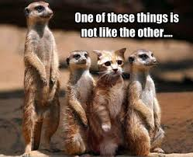
But this interest of ours in the relation between things and events rather than in the status of things in and of themselves makes us unique in the world of science. In this regard, we are not like other natural sciences.

Slide 20
And in particular, if we seek to engage with other philosophers of science, we have a problem should we care about the fact that from their perspective in evaluating FC as a thing to be evaluated in and of itself, we are not without an ontology.
Notes:
Or maybe we should be talking about this as an opportunity, as the central way by which we interact with others… As CBSers we actively, consciously choose to try and imagine the perspective of others. We value this action, this taking ourselves out of ourselves in service of validating and offering those who suffer a path of travel through the morass …

Slide 21
From their perspective, our ontology is a statement about being that involves relation with others. To them, our ontological statement is that there is no I without YOU, no HERE without THERE, no NOW without THEN.
It is also an ontological statement from the vantage of metaphysics, the branch of philosophy in which ontology is situated.

Slide 22
Further, and again from the vantage of mainstream analytic philosophy, the ontological viewpoint of functional contextualism is that what IS can be an IS only in the context of OTHER and that it is of no bearing whether IS or OTHER have independent existences, in and of themselves.
This is distinct from the perspective that what IS can be an IS only in the context of WHAT IS NOT.

Slide 23
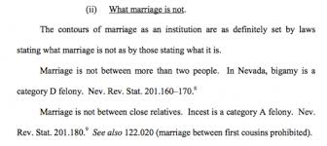
That latter ontological viewpoint characterizes most of Western philosophy, and is so embedded in our languaging about everything that others find it laughable that we should exempt ourselves from the discussion as to the existence of things in and of themselves.

Slide 24
My point, a point I consider to be consistent with FC, can be distilled to this: ontology is a word used by people, it is not a thing in and of itself.
If it can be helpful to us in building relations with other scientists to use the language of ontology to identify ourselves, then we might choose within that context to do so.

Slide 25
Just as I honor the experience of the dog with respect to my pencil and do not wave it in front of him, just as I honor the experience of the religious client and speak with him as though God is in the room with us even though I myself have no experience of this god, when I speak with philosophers of science and scientists from other disciplines, I take pains to speak in their language.

Slide 26
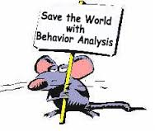
This should come as no surprise to the behavior analysts in this room, and I think that CBS can learn something from our experience in the world of applied behavior analysis… … …

Slide 27
When I am talking scientist to scientist, for the sake of precision, I speak in terms of S^{R-} and S^{R+}, S^{D}s and MOs, plys, tracks and augmentals, C_{rel}s, C_{func}s, BIRRS and EERS.
When I am talking to Aunt Sallie, I do not make her learn to speak precisely about the difference between negative and positive reinforcement. She doesn’t need to learn our technical jargon. I speak with Aunt Sallie in Aunt Sallie language, to ensure that we communicate effectively.

Slide 28
An important corollary point regarding workability and CBS goals:
CBS values communication and collaboration with others. We seek to extend our communication with other disciplines so long as this helps us to alleviate human suffering and advance human well being.

Slide 29
To the extent that communicating with scientists from other disciplines furthers these aims, talking as other scientists talk could be useful.
To the extent that it does not further our pragmatic goals, then it might not be worth the effort.
But let’s suppose communicating with scientists from other disciplines will be useful, since we do not yet know that it will not…

Slide 30
To communicate effectively with others, we can speak as if from an ontological stance. And we can in doing so, carefully explain our a-ontological position.
Our aim in speaking as if from an ontological position is to be of maximum service to greatest number of people who might otherwise not listen to what we have to say.
Not a bad reason for “acting as if”…

Slide 31
But it’s awkward and challenging – because if they are scientists and philosophers of science, we want to persuade them to see things our way. We want to teach them and convince them…
Hmm… Sounds a lot like a beginner therapist trying to coach psychological flexibility inflexibly, doesn’t it?
The solution is to invite them in without pushing them too hard. It is challenging…

Slide 32
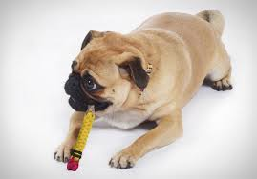
But challenging as this is, it is in the end easier and way more effective than trying to convince my dog that the pencil is not a chew toy. Good luck with that.

Slide 33
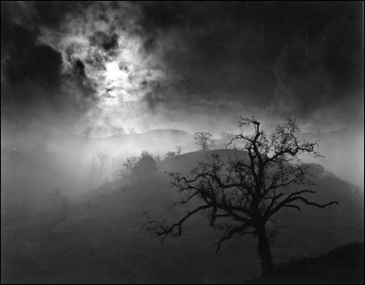
Tom Thomas G. Szabo, PhD., BCBA tszabo@fit.edu
Thank you, and let the questions that can’t be answered begin!

